Slide 1

AI Healthcare Bot System-0282
Graduation Project
2024-2025

Slide 2
Working Team
Name
ID
Ziad Walid Mohammed Ali
Ahmed Haytham Zayed Abdelrahman
Adham Haytham Zayed Abdelrahman
Mahmoud Ahmed Mohamed Ali
Mustafa Hussam Eldeen Roshdy
Mohammed Mohamed Hanaa Ahmed
20-01246
20-01752
20-00554
20-00401
19-00839
20-00873
Supervised By
Dr . Enas Elgeldawi
Eng. Mohamed Saied

Slide 3
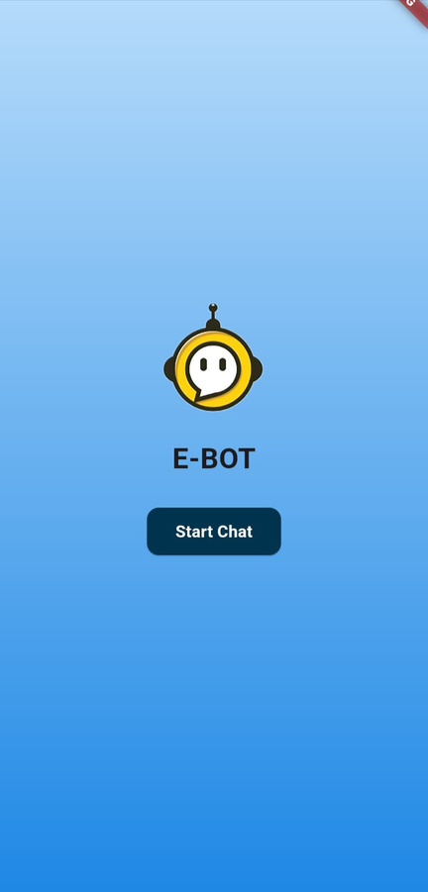
Agenda
Introduction
Problem
Motivation
Related Work
Objectives
Proposed Solutions
Technologies
Functional Requirements
Diagram
Demo
Future Work

Slide 4
Introduction

Slide 5
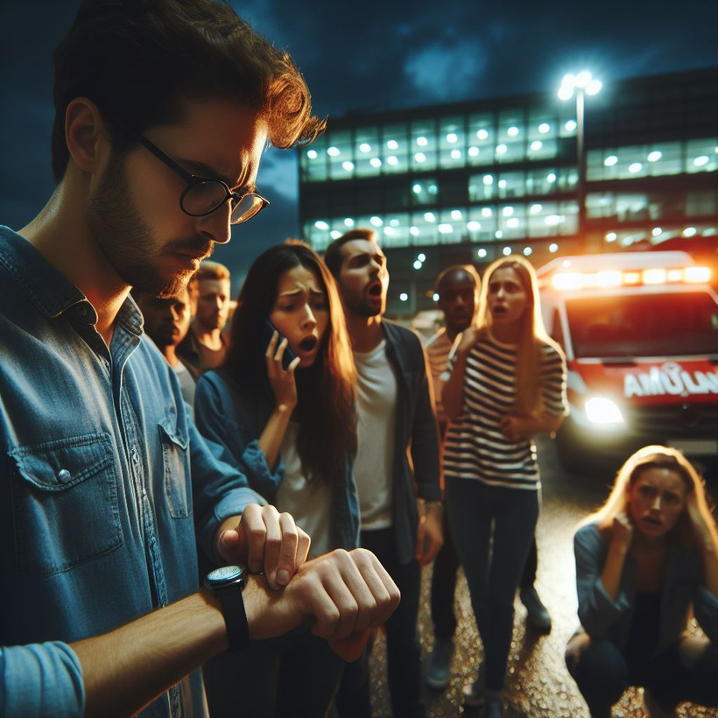
Introduction
In daily life, many people suffered to delayed first aid or lack of knowledge about nearby hospitals and emergency contact numbers.
According to the the guardian Up to 150,000 people a year could be dying unnecessarily because first aid is not widely enough known & New research shows just 5% of adults have the skills and confidence to provide first aid in emergency situations.

Slide 6

Problem

Slide 7

Problem
Delayed Emergency Response
Lack of Information
Panic and Disorientation
Communication Barriers

Slide 8
Motivation

Slide 9
Motivation
So we try to help via:
Fast Response
Easy Access For Emergency Number
Help You To Know Nearest Hospital
Speech To Text

Slide 10
Related Work

Slide 11
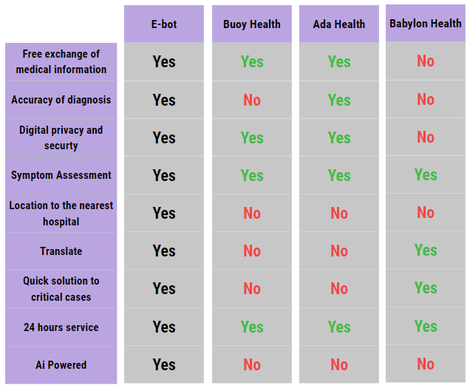


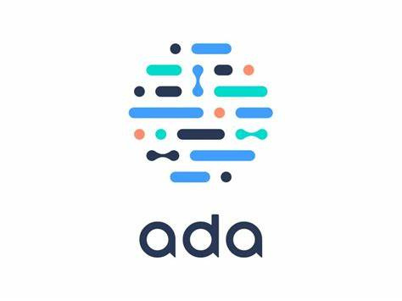

Slide 12
Objectives

Slide 13

Real-Time Assistance
Assessment of Symptoms
First Aids Guidelines
Initial support
Drive To The Nearest Hospital
User-Friendly
Objectives

Slide 14
Proposed Solution

Slide 15
Why Mobile Application?
First Aid Lack
Symptoms And Disease
Near Hospital
Emergency Numbers
Language
Solution

Slide 16
Datasets
Symptoms Dataset
Precaution Dataset
Description Dataset
First aid Dataset

Slide 17
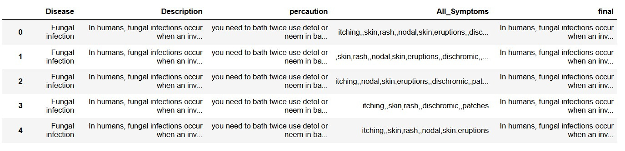
Merging Data
Record 4560 × 5 Columns

Slide 18
AI
NLP (Natural language Processing)
Multinomial Naive Bayes (MNB)
Cosine Similarity
Geolocation Algorithm

Slide 19
NLP ( Natural Language Processing)
word_tokenize
RegexpTokenizer
stopwords
WordNetLemmatizer

Slide 20
Machine Learning Models
Multinomial Naive Bayes (MNB)
Support Vector Machine
Deep Learning Model
Sequential Model (RNN)

Slide 21
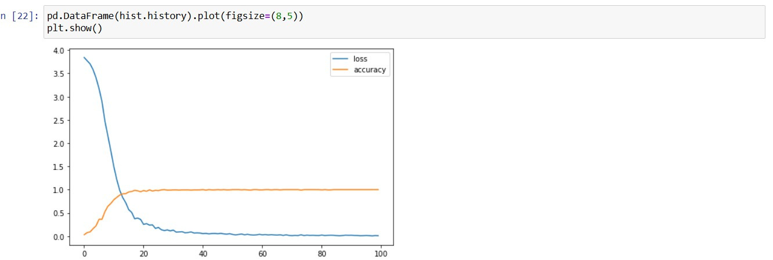
Accuracy
Sequential Model

Slide 22
Machine/Deep Learning Models Accuracy
Model name | Accuracy
Multinomial Naive Bayes (MNB) | 95%
Support Vector Machine (SVC) | 98%
Sequential Model (RNN) | 97%

Slide 23
Rasa Framework
Why we chose Rasa
intents and stories in Rasa

Slide 24
Rasa Framework
Actions in rasa
Disease Prediction and Precautions
Integrated the machine learning model with Rasa actions. When users input their symptoms, the chatbot predicts the disease and provides relevant precautions.
Disease info
Developed a function to fetch and summarize information about diseases from Wikipedia. Allows users to ask about any disease, and the chatbot provides a summarized answer from Wikipedia.

Slide 25
Rasa Framework
Natural Language Processing (NLP) Techniques:
Employed various NLP techniques to preprocess and analyze user input.
Trained an NLU model in Rasa to understand and extract user intents and entities

Slide 26
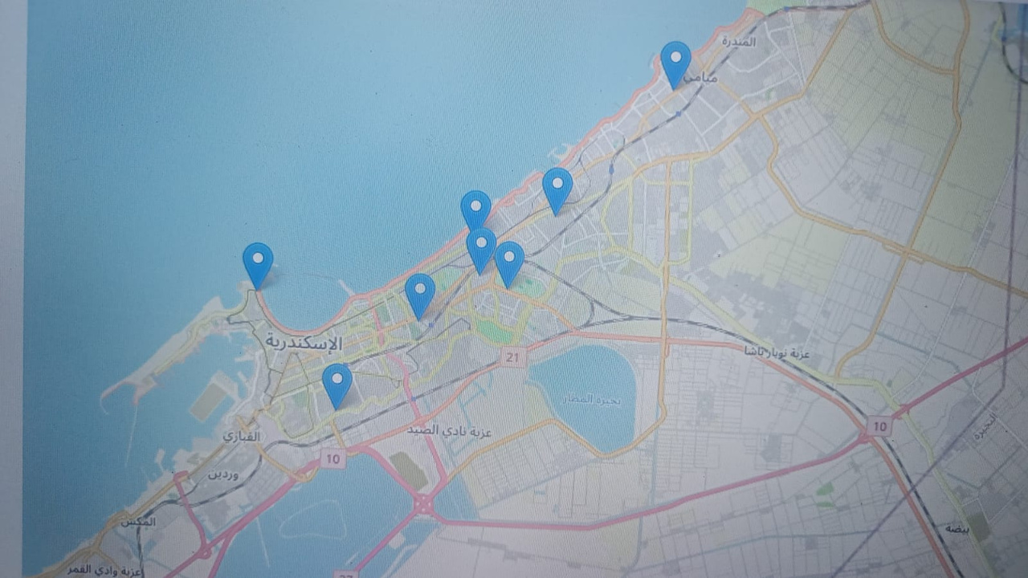
Geolocation Algorithm
User Location
Initial and Maximum Radius
Get the list of hospitals
Map Initialization
Add Markers
Directions Link
Display the Map

Slide 27
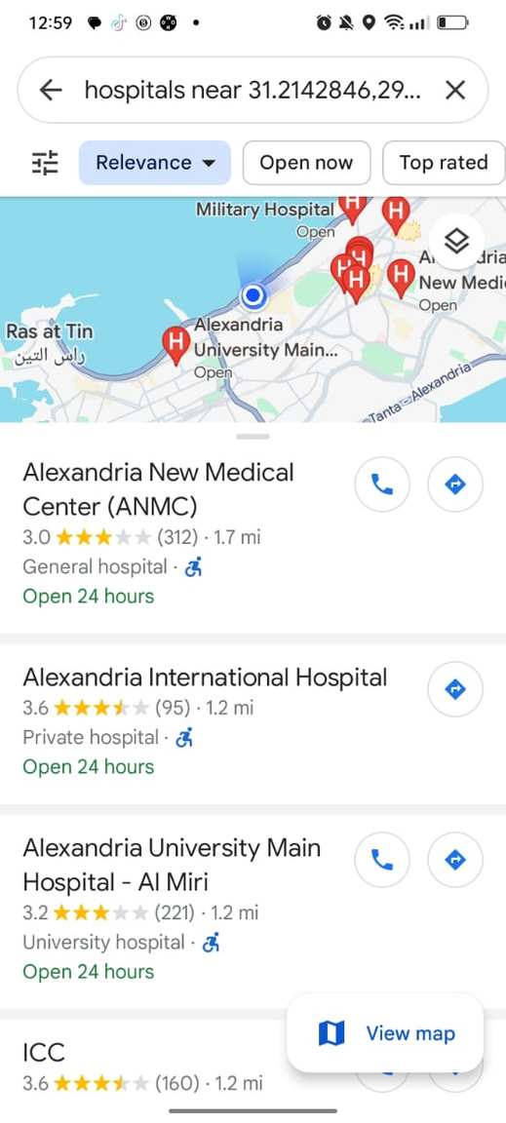
Geolocation Algorithm
Request Permission And Fetch Location
Get Current Location
Open Google Maps

Slide 28

Multi-Language
Languages Supported:
English
Spanish
French
Dataset Preparation:
Gathered intent and response data for the primary language (English).
Translated the dataset into Spanish and French to ensure comprehensive language support.

Slide 29
Technologies

Slide 30




Backend Language
Python
Rasa Frame Work
Mobile App Development Framework
Flutter
UI/UX (Figma)

Slide 31

Functional
Requirements

Slide 32
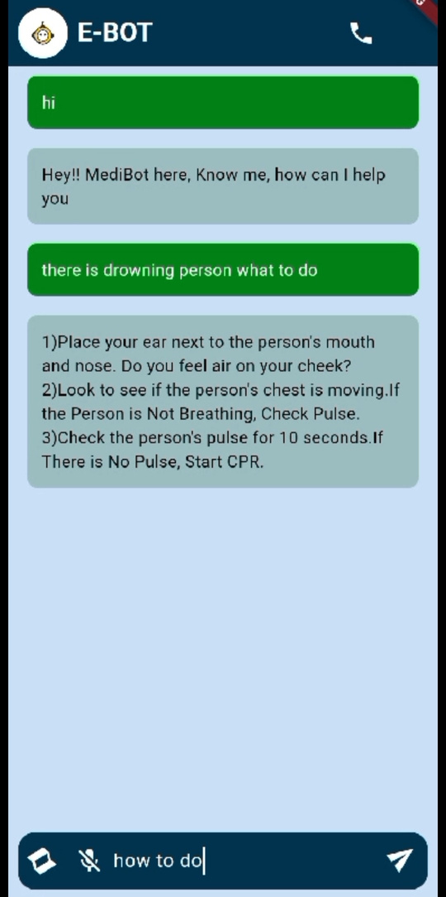
Functional Requirements:
Chat Messaging
Speech To Text
Emergency Calling
Location To The Nearest Hospital
Multilingual
Cache Memory

Slide 33
Diagram

Slide 34
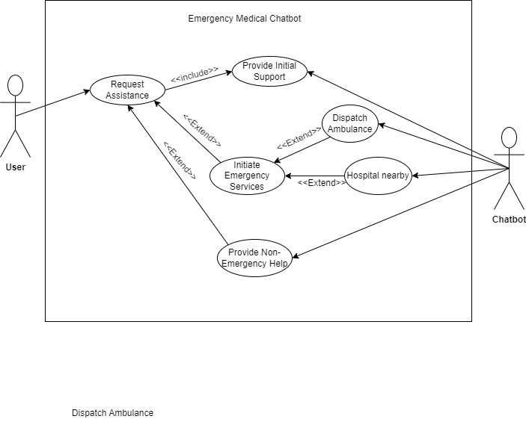

Slide 35
Demo

Slide 36
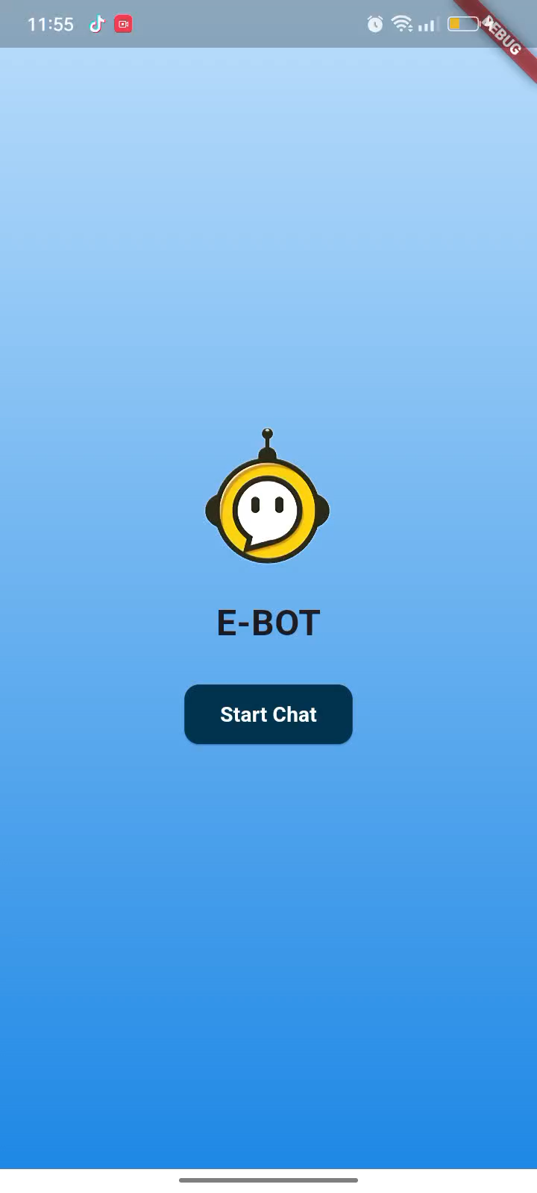

Slide 37
Future Work

Slide 38
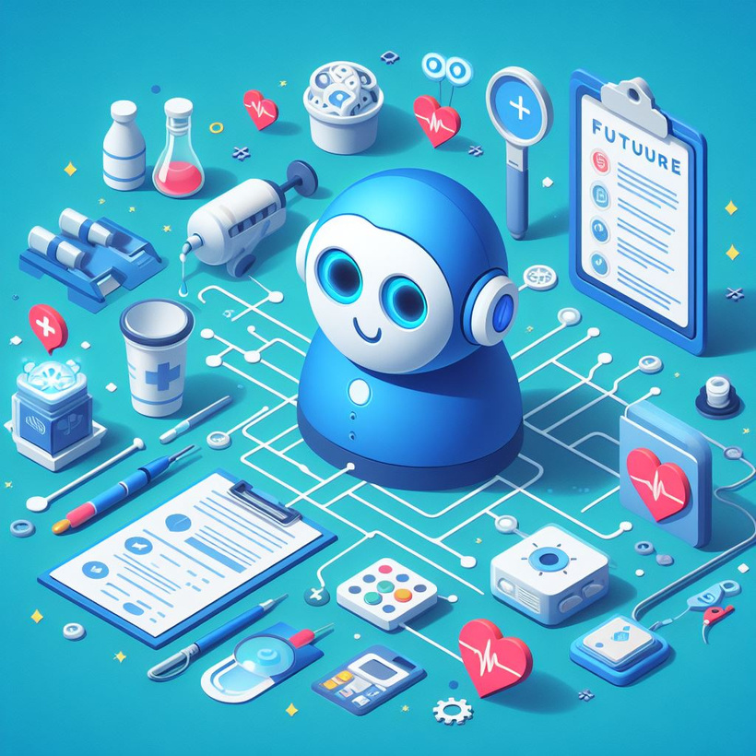
Future Work
World-Wide Chatbot
Mental Health Support
Expansion of Multilingual Support
Telemedicine Integration
Integration With Wearable Devices
User Personalization

Slide 39
Thank You

